Slide 1
Day 4

Slide 2
Objectives
Generic introduction in Collection
Collection and its types
List - LinkedList, ArrayList
Set - Hashset, LinkedHashSet, Treeset
Map - HashMap, LinkedHashMap, TreeMap

Slide 3
Generic introduction in Collection
D1
Generics mean parameterized types. The idea is to allow type (Integer, String, …) to be a parameter to methods, classes. Using Generics, it is possible to create classes that work with different data types.
The Object is the superclass of all other classes and Object reference can refer to any type object.
These features lack type safety. Generics add that type safety feature.

Slide 4
Generic introduction in Collection
D2
Generic Class
We will create a generic class
How to create generic class
Class class_Name <T> {
}
Generic Functions: We can also write generic functions that can be called with different types of arguments based on the type of arguments passed to the generic method
D3
D4

Slide 5
Generic introduction in Collection
Generic in collection
So in collection we can also implement type safety
Ex –
ArrayList al = new ArrayList();
al.add(“Bhushan");
al.add(“Archit");
al.add(10);
here any type of data can be enter but let’s say I want to create a collection String type then I need to write following code.
We can create collection like generic that is type safety.
ArrayList<String> al = new ArrayList<String>();
al.add(“Bhushan");
al.add(“Archit");
al.add(10);

Slide 6
Collection and its types
Before we start learning collection we should know why it came in picture.
Array - >used to represent a group individual element as single entity.
Array – 1. Fixed size
2. Same data type
3. No underlying data structure

Slide 7
Collection and its types
In order to overcome drawback of Arrray collections came in picture.
Collection- Collection is an interface which is used to represent a group of individual object as a single entity.

Slide 8
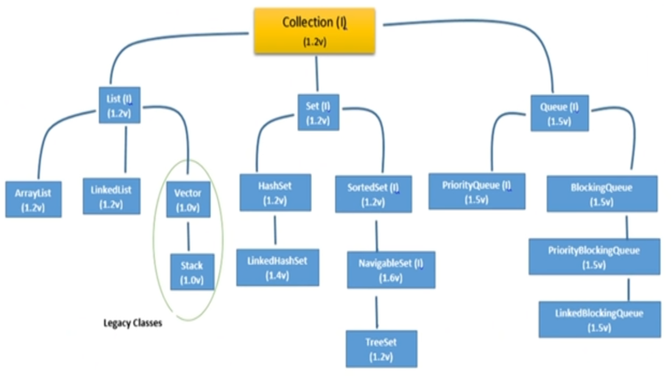
Collection types

Slide 9
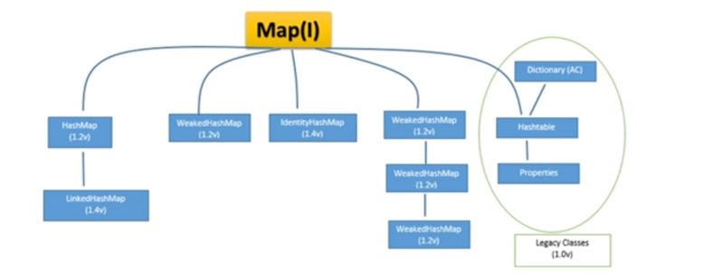
Collection types

Slide 10
Collection types
Collection | Collections
It is an interface. | It is a utility class.
It is used to represent a group of individual objects as a single unit. | It defines several utility methods that are used to operate on collection.

Slide 11
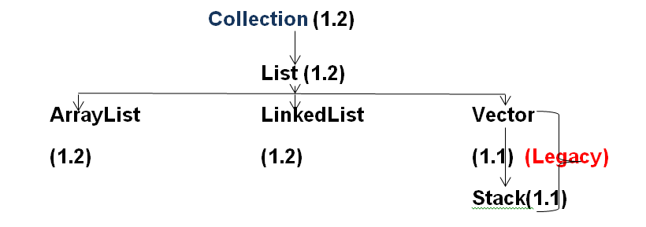
List
List is child interface of Collection and where in the group of object as a single entity duplicates are allowed and insertion order is preserved.

Slide 12
ArrayList Class
The underlying architecture of ArrayList is Resizable or Growable
Duplicates are allowed
Insertion order is preserved
Heterogeneous objects are allowed
Null insertion is possible

Slide 13
LinkList Class
Key points for LinkedList are as follows-
The underlying data structure of LinkedList is double link list
Insertion order is preserved
Duplicates are allowed
Heterogeneous objects are allowed
Null insertion is possible

Slide 14
Commonly use Methods of List
void add(int index, E element) | It is used to insert the specified element at the specified position in a list.
Boolean addAll(int index, Collection<? extends E> c) | It is used to append all the elements in the specified collection, starting at the specified position of the list.
void clear() | It is used to remove all of the elements from this list.
boolean remove(Object o) | It is used to remove the first occurrence of the specified element.

Slide 15
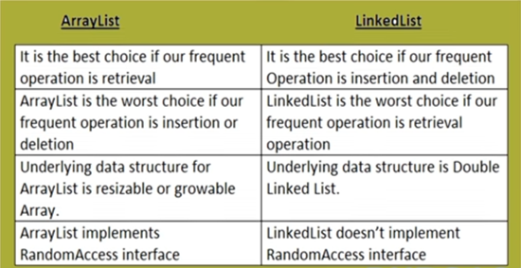
ArrayList Vs LinkList Class
D5
D6

Slide 16
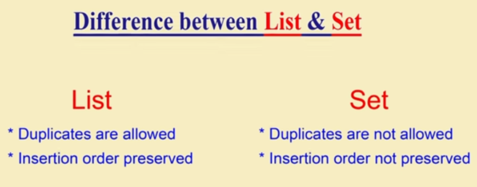
Set
Set is child interface of Collection framework and where duplicate objects are not allowed and insertion order is not preserved

Slide 17
Set
Java HashSet - class is used to create a collection that uses a hash table for storage. It inherits the AbstractSet class and implements Set interface.
HashSet stores the elements by using a mechanism called hashing.
HashSet contains unique elements only.
HashSet allows null value.
HashSet class is non synchronized.
HashSet doesn't maintain the insertion order. Here, elements are inserted on the basis of their hashcode.
HashSet is the best approach for search operations.
D7

Slide 18
Set
Java LinkedHashSet class is a Hashtable and Linked list implementation of the set interface. It inherits HashSet class and implements Set interface.
The important points about Java LinkedHashSet class are:
Java LinkedHashSet class contains unique elements only like HashSet.
Java LinkedHashSet class provides all optional set operation and permits null elements.
Java LinkedHashSet class is non synchronized.
Java LinkedHashSet class maintains insertion order.
D8

Slide 19
Set
Java TreeSet class implements the Set interface that uses a tree for storage. It inherits AbstractSet class and implements the NavigableSet interface. The objects of the TreeSet class are stored in ascending order.
The important points about Java TreeSet class are:
Java TreeSet class contains unique elements only like HashSet.
Java TreeSet class access and retrieval times are quiet fast.
Java TreeSet class doesn't allow null element.
Java TreeSet class is non synchronized.
Java TreeSet class maintains ascending order.
D9

Slide 20
Map
Map is child interface of Collection
If we want to use group of objects as key value pair then we can use Map interface.
Example-
Roll No. | Name
101 | Bhushan
102 | Syed
103 | Bhushan

Slide 21
Map
Java HashMap class implements the Map interface which allows us to store key and value pair, where keys should be unique. If you try to insert the duplicate key, it will replace the element of the corresponding key. It is easy to perform operations using the key index like updation, deletion, etc. HashMap class is found in the java.util package.

Slide 22
Map
Java HashMap contains values based on the key.
Java HashMap contains only unique keys.
Java HashMap may have one null key and multiple null values.
Java HashMap is non synchronized.
Java HashMap maintains no order.
D10

Slide 23
Map
LinkedHashMap
Points to remember
Java LinkedHashMap contains values based on the key.
Java LinkedHashMap contains unique elements.
Java LinkedHashMap may have one null key and multiple null values.
Java LinkedHashMap is non synchronized.
D11

Slide 24
Map
D12
Java TreeMap class
The important points about Java TreeMap class are:
Java TreeMap contains values based on the key. It implements the NavigableMap interface and extends AbstractMap class.
Java TreeMap contains only unique elements.
Java TreeMap cannot have a null key but can have multiple null values.
Java TreeMap is non synchronized.
Java TreeMap maintains ascending order.

